Slide 1



Small Project as Education tool for developing of Competences
Pavle Tvaliashvili
Georgia

Slide 2

Small Project as Education tool for developing of Competences
Background
Tool Description
Possibilities to using in youth work
Reflection

Slide 3
Small Project as Education tool for developing of Competences
Background
Our 10 year experience of working with youth during non-formal education activities in Georgia.
About 4 years ago Ministry of education start use projects in Formal Education.

Slide 4

Small Project as Education tool for developing of Competences
Definition of Project is:
Unity of activities
Aim/Objectives
Time bounded (start and finish dates)
Budget (resources)
Team of people

Slide 5
Small Project as Education tool for developing of Competences
Tool Description
steps:
Planning
Preparation
Implementation
Presentation/Evaluation

Slide 6
Small Project as Education tool for developing of Competences
PHASE |  | issue | plan | prepare | implementation | Evaluation
1 | Leader | + | + | + | + | +
 | Youth | - | - | - | + | -
2 | Leader | + | + | + | - | +
 | Youth | - | - | + | + | -
3 | Leader | + | - | - | - | +
 | Youth | - | + | + | + | -
4 | Leader | - | - | - | - | -
 | Youth | + | + | + | + | +

Slide 7
Small Project as Education tool for developing of Competences
Possibilities to use in youth work
Students from 11 years old
Young People
YPWFO
retired people
Small groups 3-5 participants in each.

Slide 8
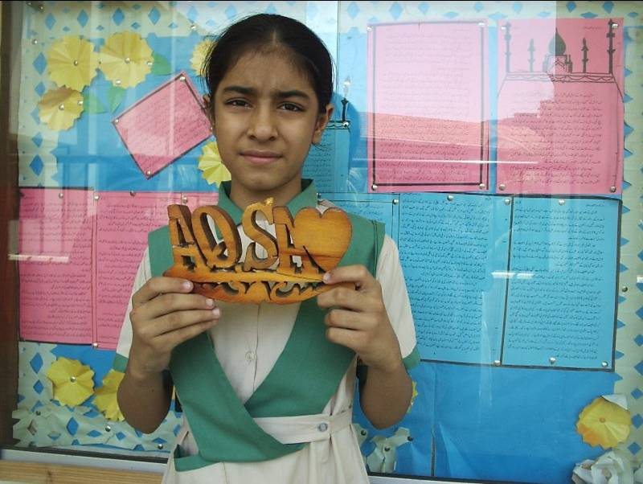
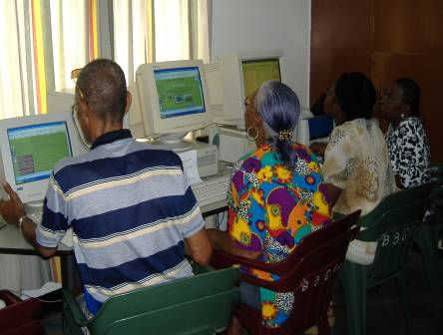
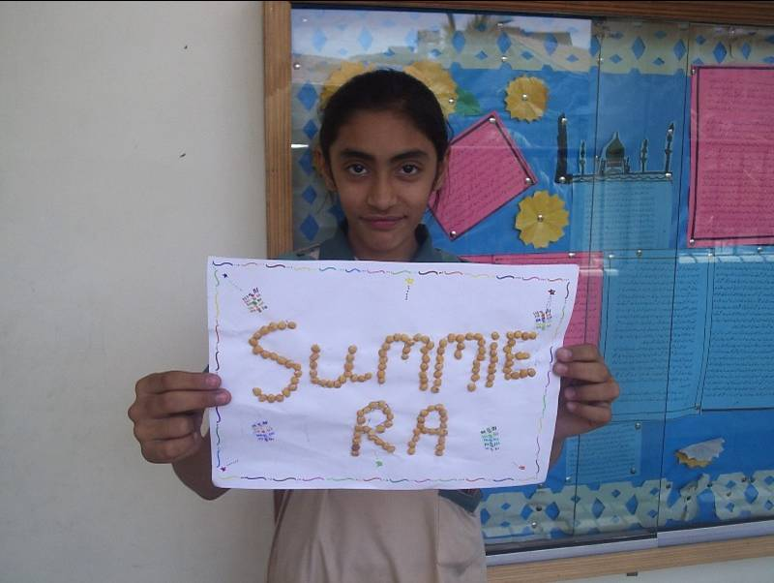
In Action

Slide 9
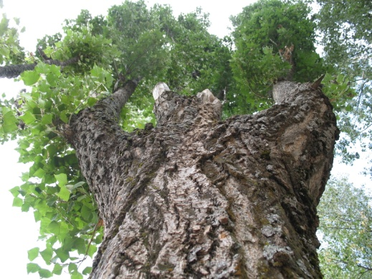
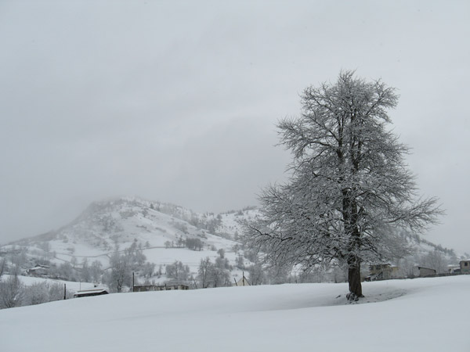
Small Project as Education tool for developing of Competences
Name: TREE NEAR US
Participants FIND AND DESCRIBE TREES IN LOCAL COMMUNITY.
STUDENTS CAN DRAW, MAKE PHOTO, WRITE ESSAY AND TALES ABOUT THIS TREE, MAKE POSTERS in GROUPS.
Working in small groups in the Park near Palace
Presentations (presentation on the flipcharts; images or PPT)

Slide 10
Small Project as Education tool for developing of Competences
Which competence (KSA) is it possible to develop by project?
We need to check before and after action
What s/he Know;
What s/he can to do;
What is his/her Attitude

Slide 11
Small Project as Education tool for developing of Competences
Key competences for lifelong learning
communication in the mother tongue;
communication in foreign languages;
mathematical competence and basic competences in science and technology;
digital competence;
learning to learn;
social and civic competences;
sense of initiative and entrepreneurship;
cultural awareness and expression.

Slide 12
Small Project as Education tool for developing of Competences
Reflection
How can we use small project?

Slide 13


Small Project as Education tool for developing of Competences
www.iearn.org
(International Education and Resource Network)
http://eno.joensuu.fi ENO-Environment Online is a global virtual school

Slide 14
Small Project as Education tool for developing of Competences
Pavle Tvaliashvili
www.pavletvaliashvili.blogspot.com
Thank you!
☺

